Slide 1

NTU Events Website v1
“Need a break? Find the latest events from all clubs and societies now!”

Slide 2
The Problem
If a student wishes to find out about a CCA's upcoming events, he has to visit the official CCA directory page first, before entering the CCA's website.
This is a time-consuming process which severely limits student awareness and participation.
Besides, most of the club sites are dead…

Slide 3
Solution
Aggregate all CCA Events in one site
Serves as a convenient platform for students to get latest updates on upcoming activities
CCAs events can reach a wider student audience
Promotes student club activities

Slide 4

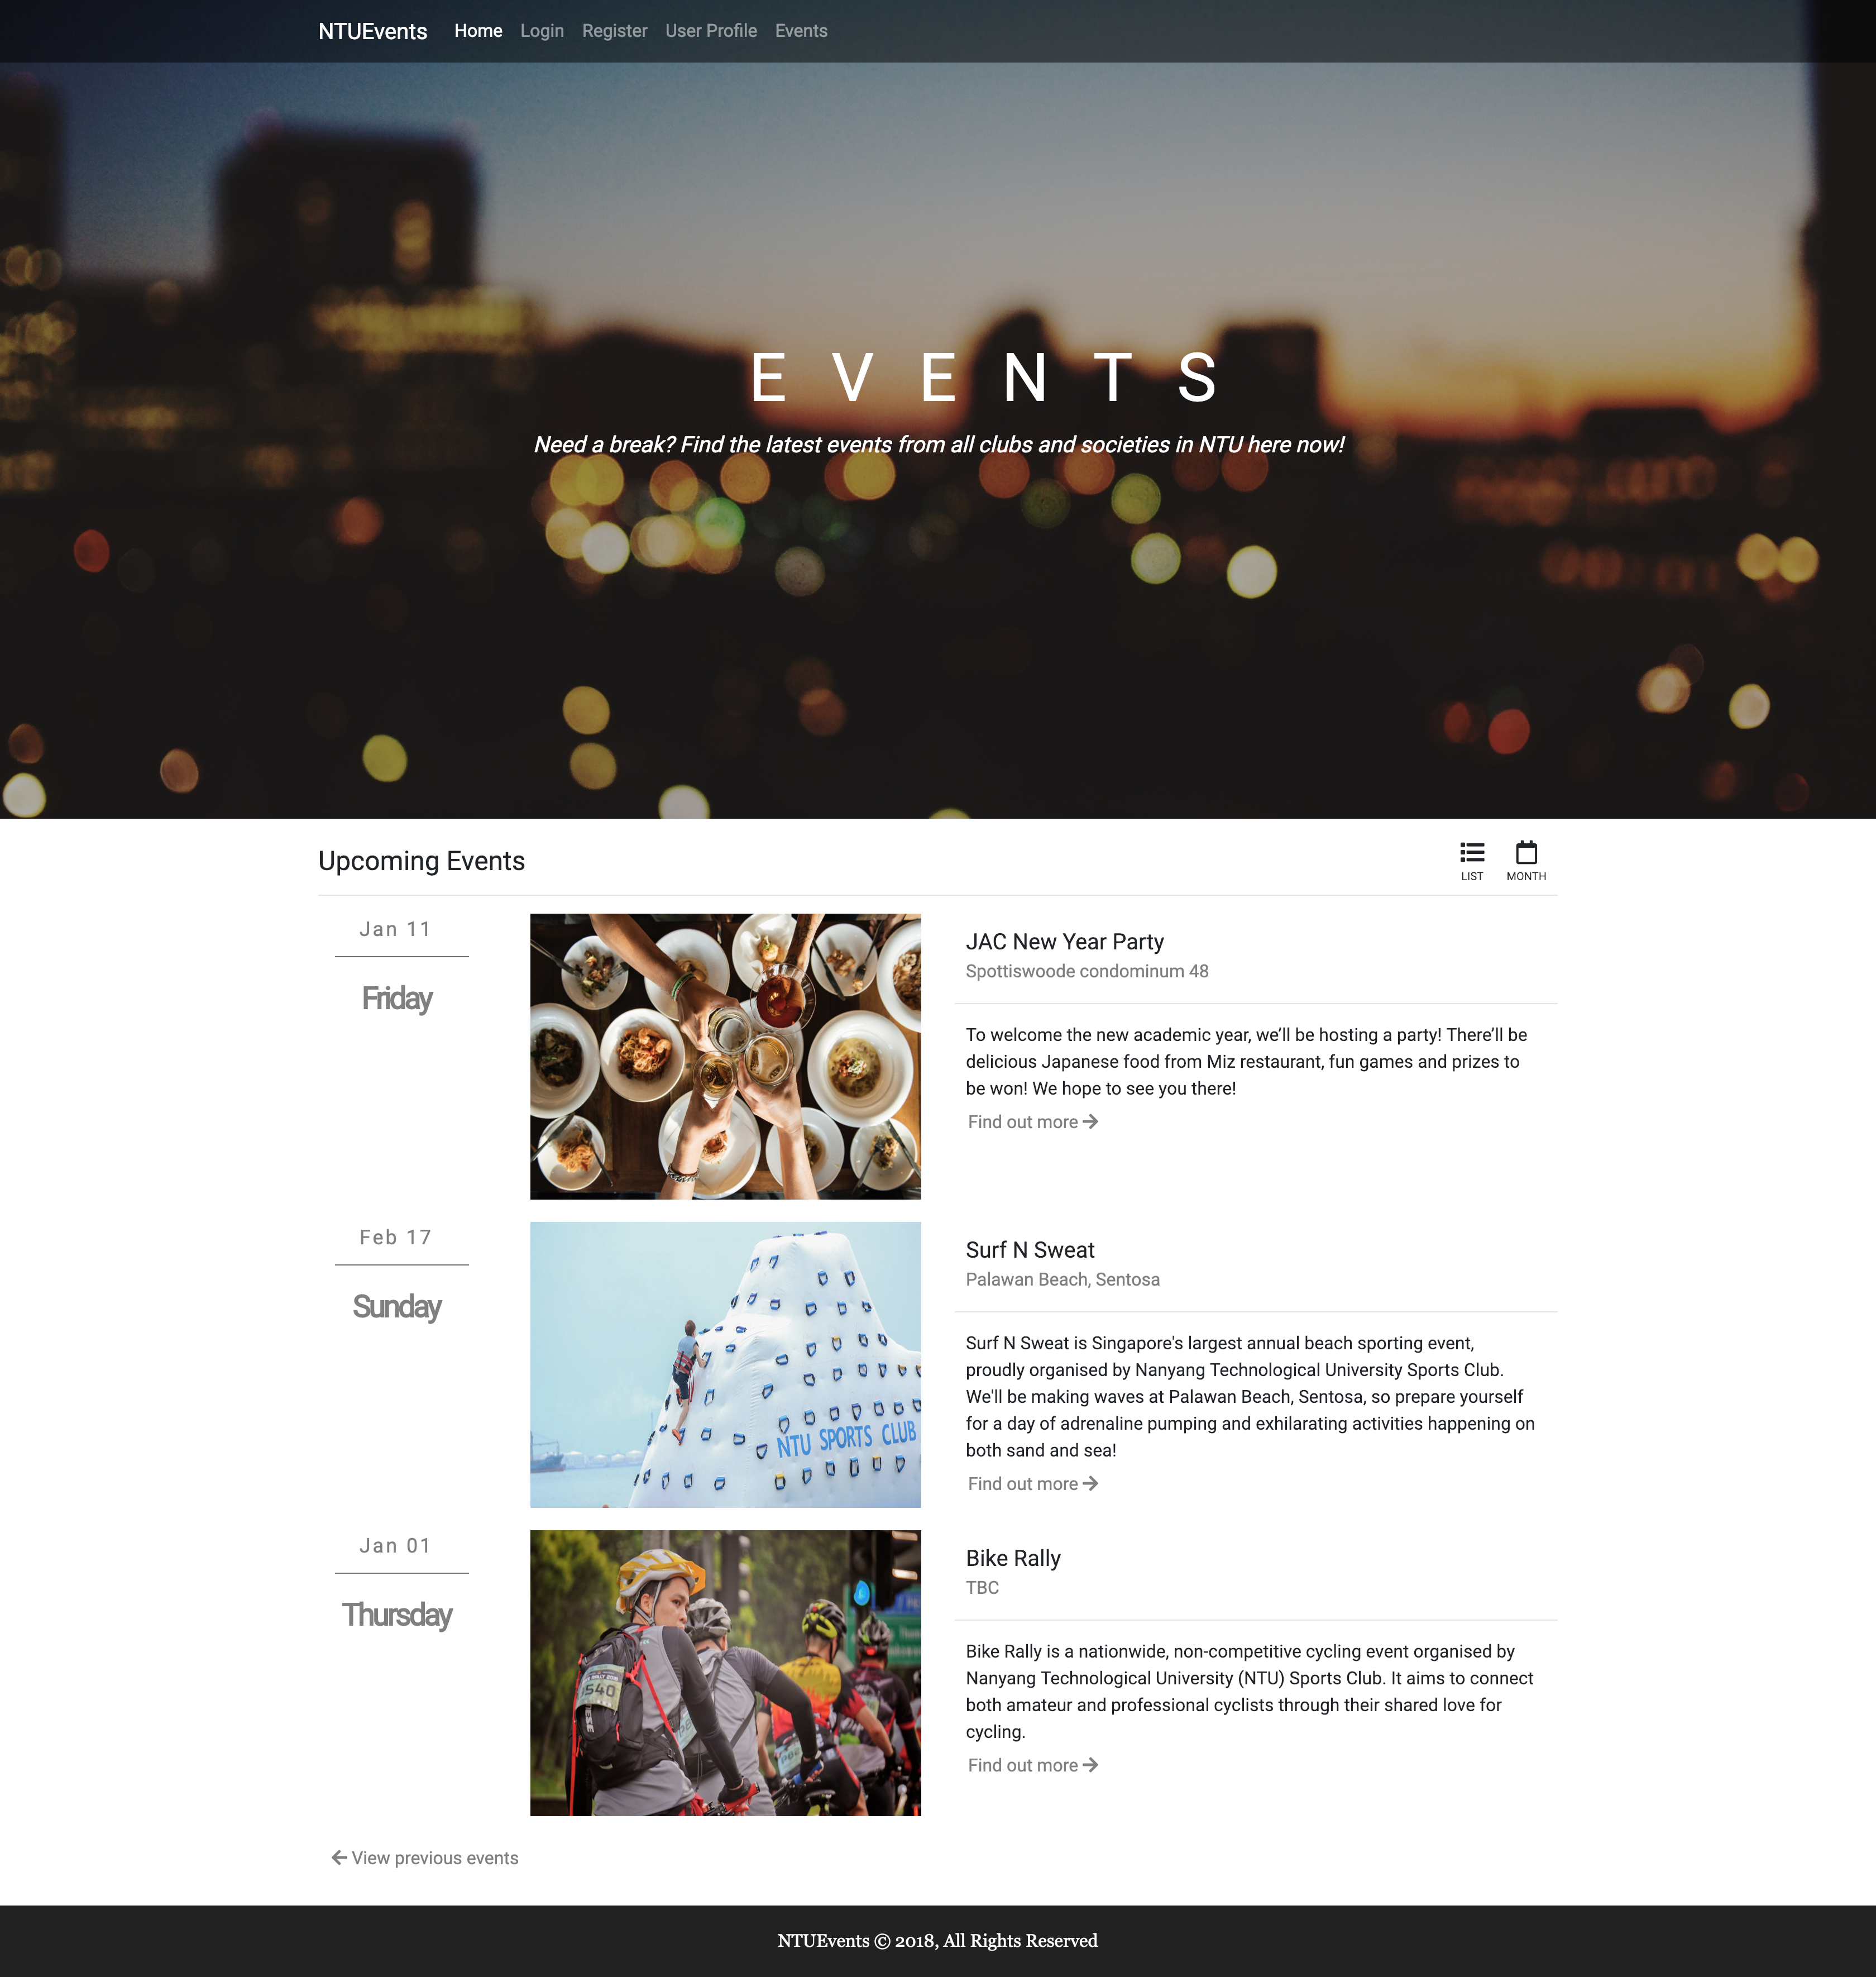
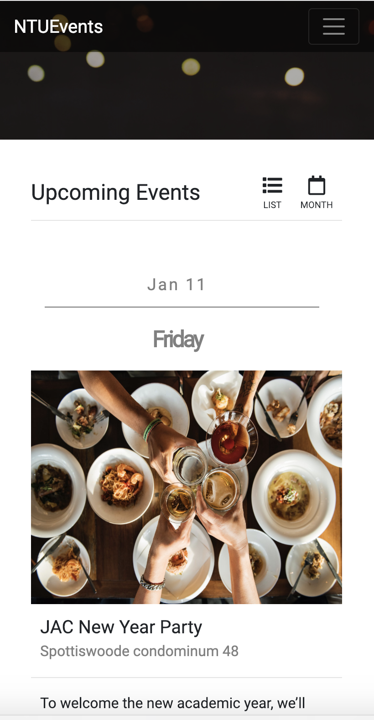
NTU Events Site v1.0 Front End Design
Basic
Informative
Club registration link (google docs) will be provided
Mobile Responsive

Slide 5
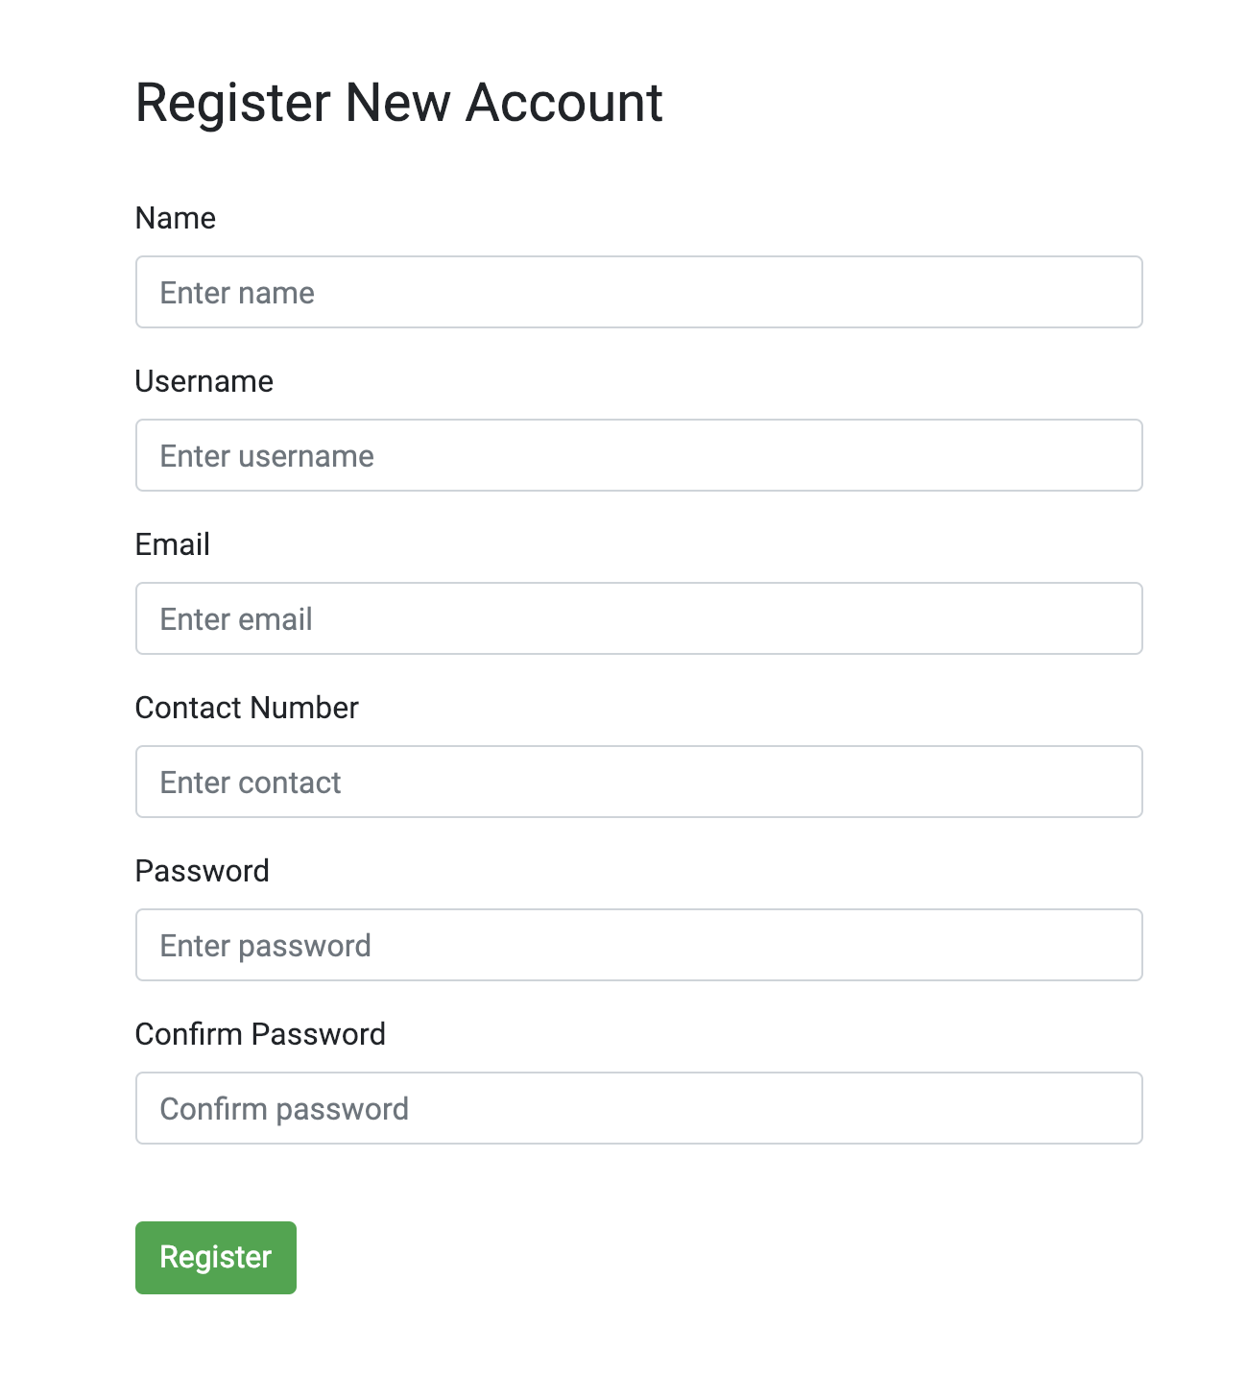
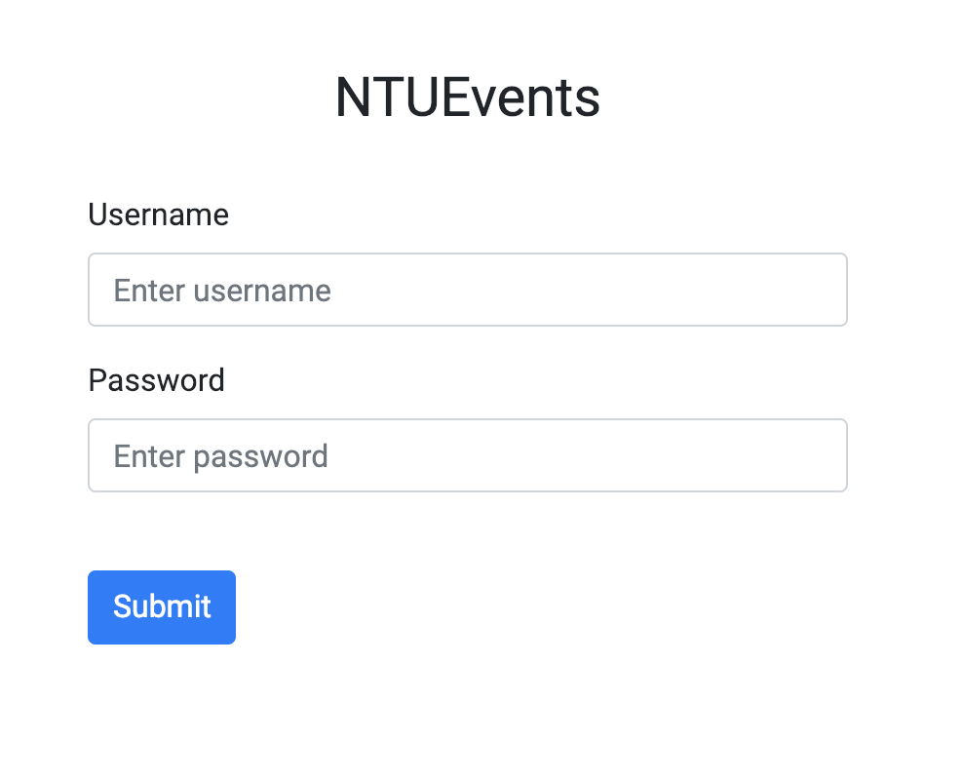
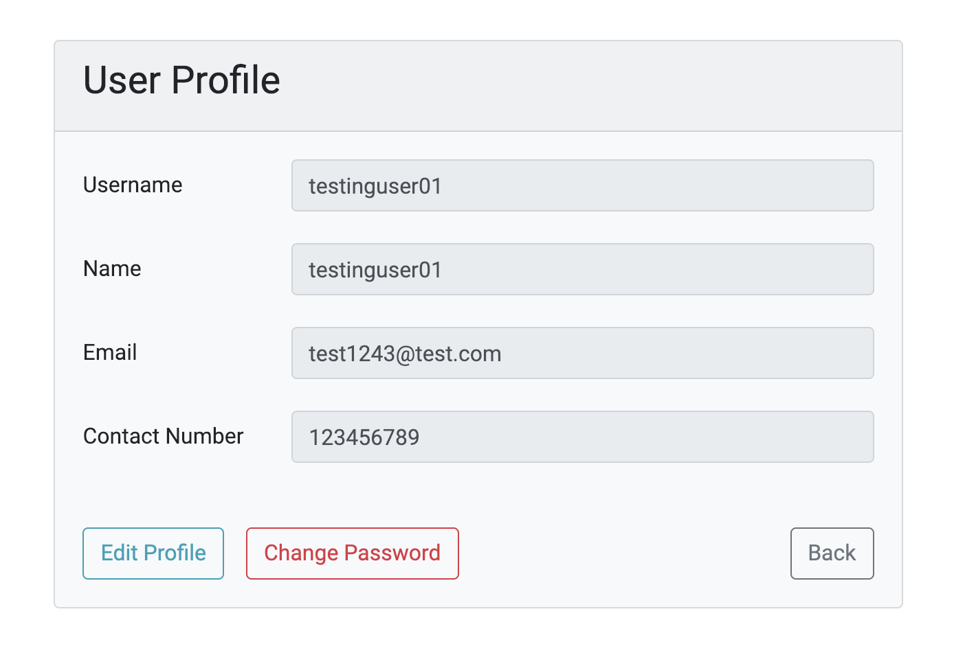
NTU Events Site v1.0 Back End Design
Login/Register for club and societies
Able to customize their profile

Slide 6
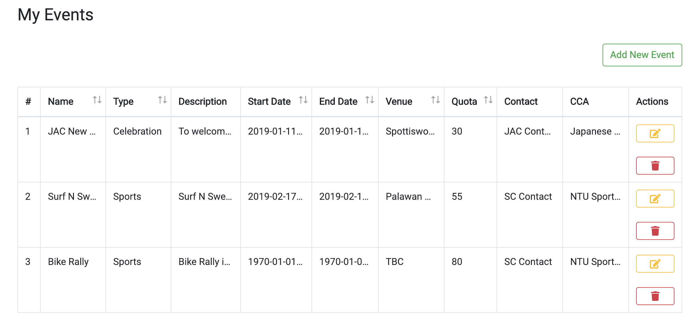
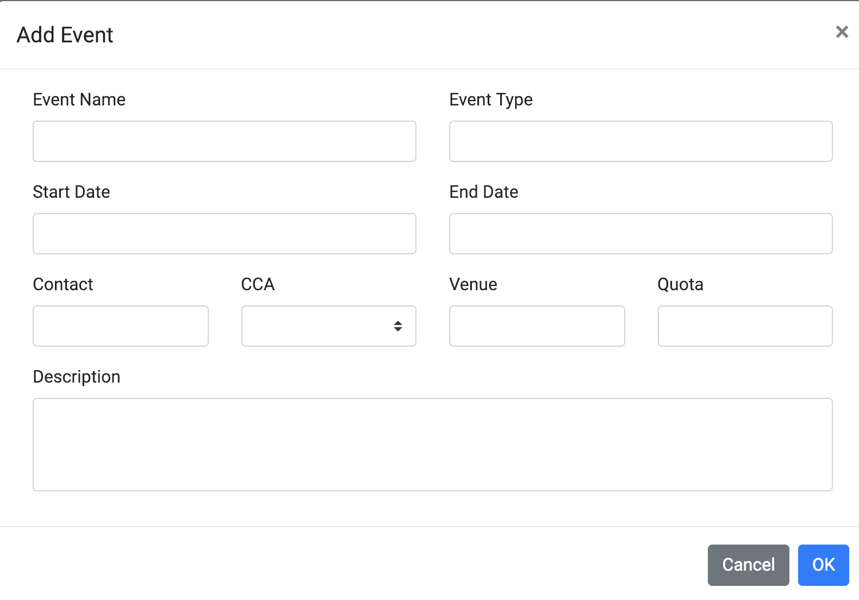
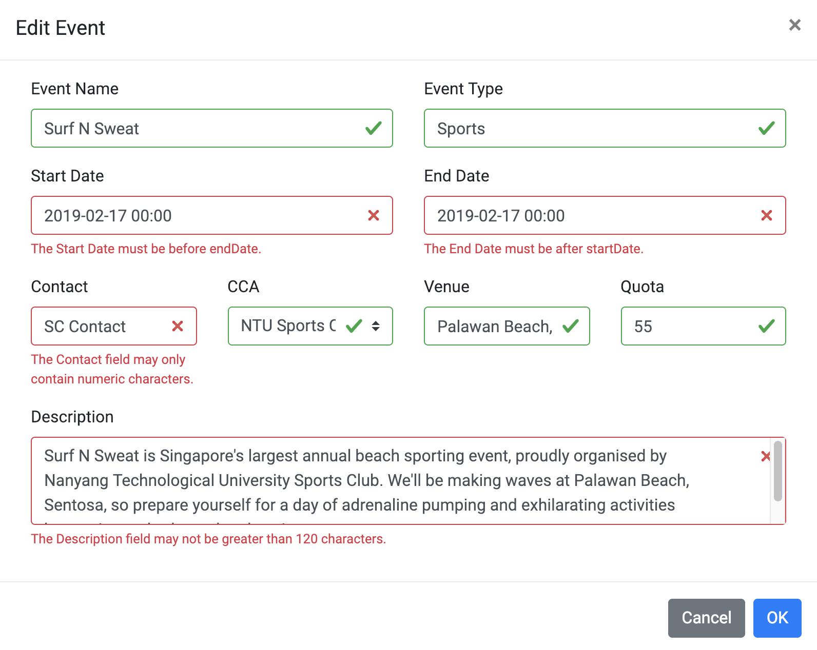
NTU Events Site v1.0 Back End Design
Able to manage their own events
Perform CRUD

Slide 7
Technical Details
Front end application (www.ntuevents.com)
Vue JS framework
Bootstrap/Datetimepicker (Design)
Axios (API Calls)
VeeValidate (Client side validation)
MomentJS (DateTime)
Nprogress (ProgressBar)
Font Awesome Free (Icons)

Slide 8
Technical Details
Web API Application (web.ntuevents.com/api/xxx)
ASP.NET Core Web API 2.2
Entity Framework (Object-relational mapper)
MySQL (Relational database management system)

Slide 9

Server architecture diagram
Deployed to Azure
Vue App (Storage)
Web API (App Svc)
Request
Send
Continuous integration
Github
MySQL (SQL Server)
Client Computer

Slide 10
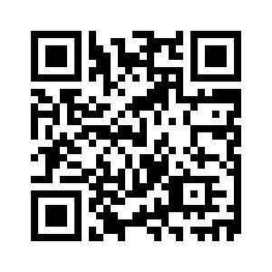
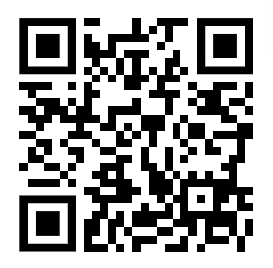
Demo
Website link at: https://ntueventsapp.z23.web.core.windows.net
Sample API Link at: http://web.ntuevents.com/api/events/1
Database hosted at: ntuevent.mysql.database.azure.com;port=3306
Website link
Sample API Link

Slide 11
Support from NTUOSS (What we need)
Manpower: 2-3 more members + Experienced tech committee
Time Period: 1-2 semester or more (depending on new features)
Commitment: Light-Medium (Meetup once every 2 weeks if there’s any update)
Experience: Basic (React/Angular/Vue) or C#/Java or HTML/CSS/JS will do
Open to ideas to improve the website further
Requires help from NTUOSS to work with Student Union to get all club and societies to use the website
Currently it’s a two man project

Slide 12
Questions?

Slide 13
Thank you! ☺

